Slide 1
International statistics: Beyond the simple collation of national official statistics
Sibylle von Oppeln-Bronikowski
Head of the Department “Strategy and Planning, International Relations, Research and Communication”
sibylle.oppeln@destatis.de

Slide 2
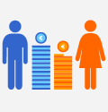
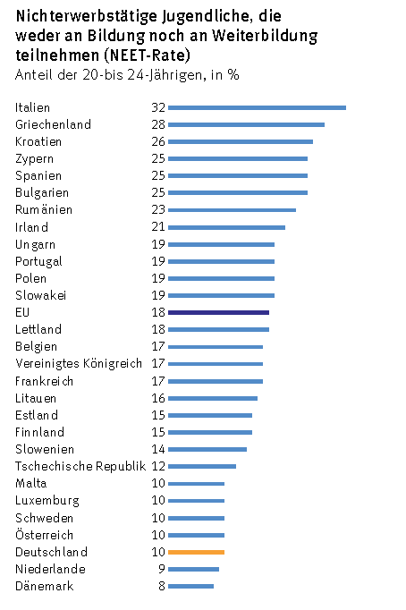
Comparisons are the essence of statistics
Pay gap between women and men
Crime in the course of time
Comparison of youth unemployment
between regions or countries
Press releases
Germany compared with other countries

Slide 3
International statistics
Comparisons are the essence of statistics, but not everything should be compared:
Differences in definitions, classifications and methodologies
Discrepancies between national and international statistics
…
International
organisations
NSIs

Slide 4
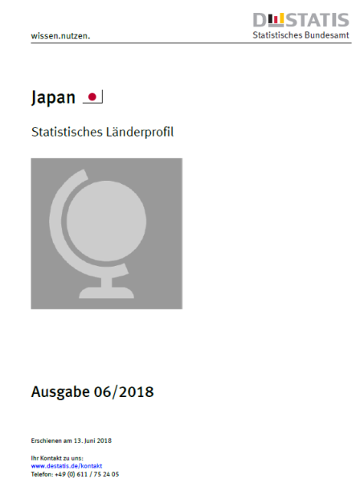
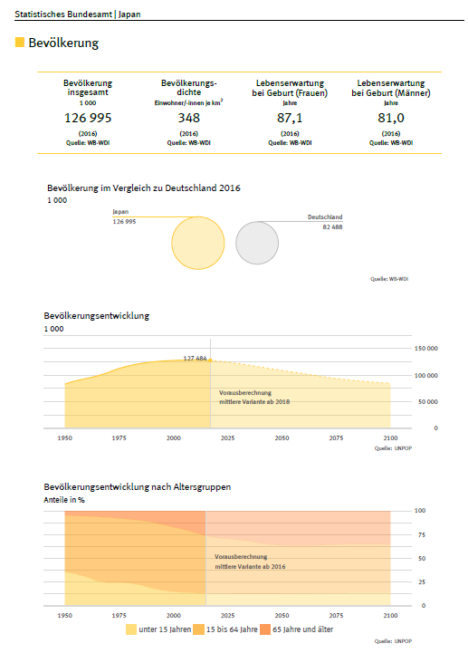
Dynamic reporting: Automatic creation of country profiles
Data from numerous official sources (World Bank, IMF, FAO etc.)
Reports published dynamically for all 193 UN Member States
Tables, charts and texts all generated automatically using R, knitR, LaTeX
Reports updated regularly
Next steps: English version (Nov. 2018) and HTML reports (2019)
4

Slide 5
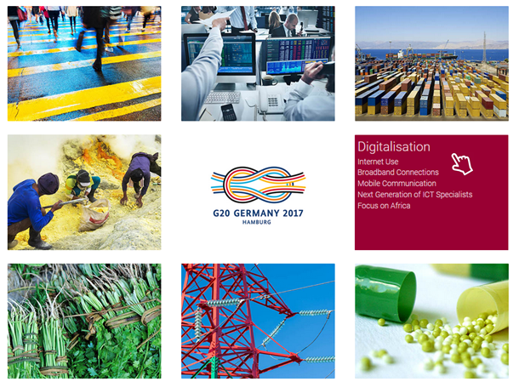
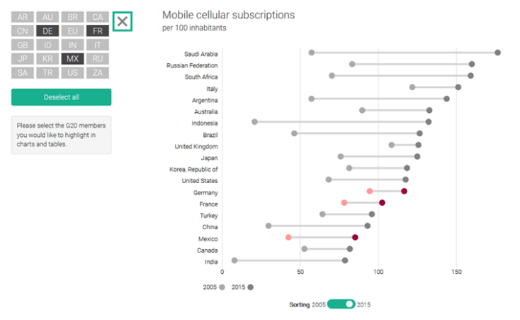
G20 in figures: Interactive publication on summit issues
Digital publication with interactive charts
Published to coincide with G20 summit in Hamburg 2017
Publication addresses focus topics of summit such as climate change, digital society, antibiotic resistance etc.
Data sources: IMF, World Bank, OECD etc.
Aim: provide attractive online alternative to print publications and thereby facilitate transition to digital era
https://service.destatis.de/G20/en/
5

Slide 6
Staying relevant to users

Slide 7
What is the key?
International organisations and NSIs – Joint responsibility!
Data and metadata – Transparent methods!
Adjustments of national data for international statistics in cooperation with NSIs
Quality – including coherence – is our unique selling point!
We can do better: the more NSIs see themselves as part of the international statistical system, the higher the benefit and relevance of national data will be.

